Slide 1




Acharya Nagarjuna University

Slide 2

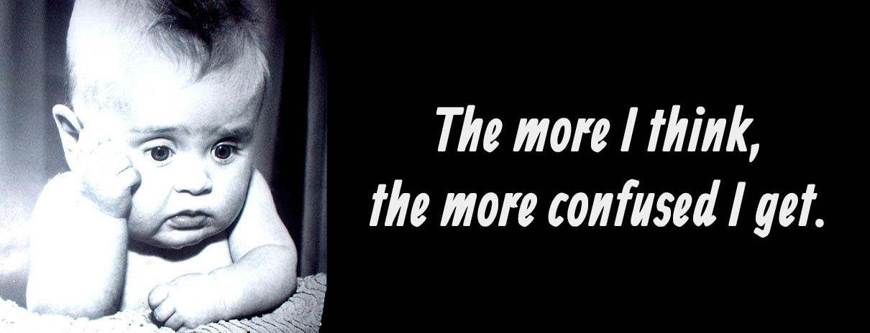
Confused in comparison between
E- marketing sites?

Slide 3



Presenter- Wasim
Behind the program- Sushil
Chandrika
Devika
Vasanth

Slide 4



So we made a website to compare the
Prices, Specifications, Reviews and Ratings
of two E-Commerce giants...

Slide 5

Pin Yin

Slide 6



